Slide 1
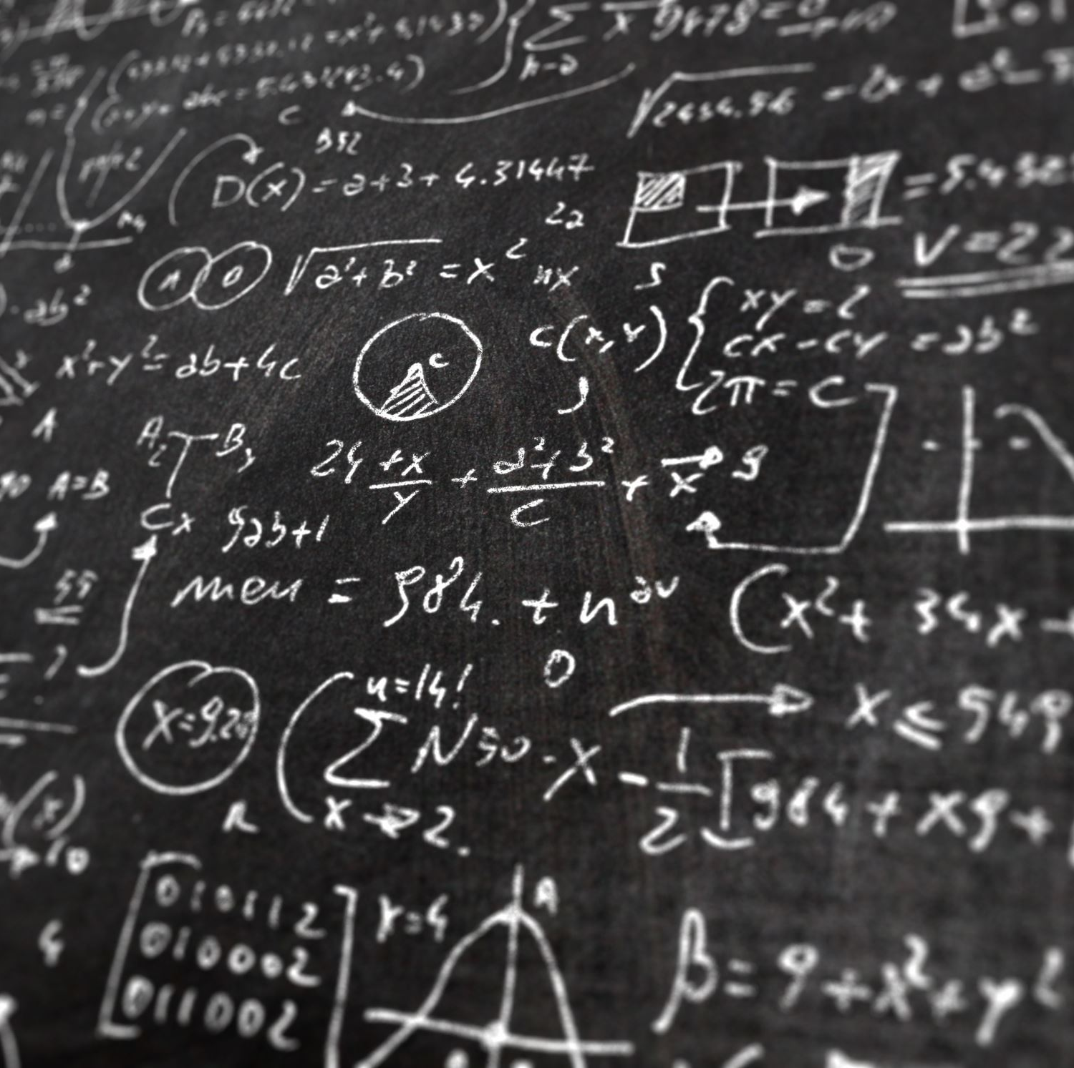
Predicting Handwritten Math Symbols
Tiffany Boswell

Slide 2
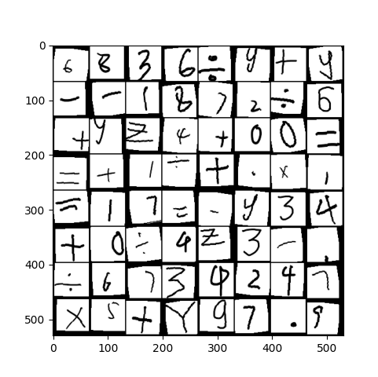
Dataset
Consists of 100s of pictures of handwritten math symbols
Classes are 0-9, add, div, dec, eq, mul, sub, x, y, z

Slide 3
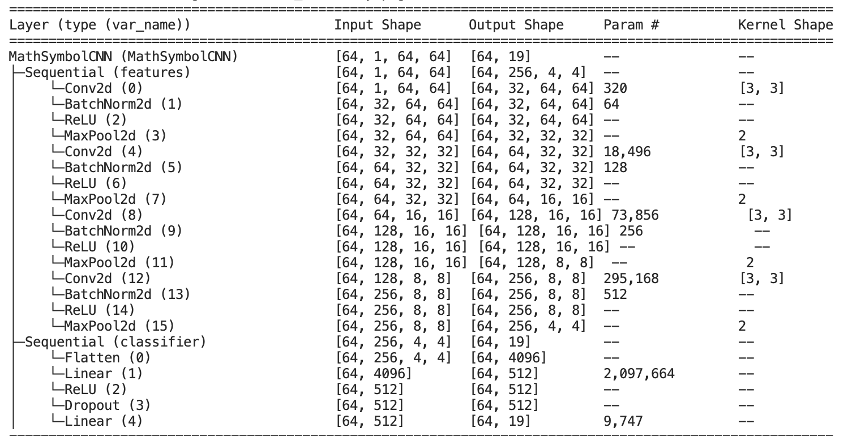
Training
Split data 80% training, 20% testing
Adam optimizer
  Weight decay: 1e-4
Model
35 epochs
Learning rate 1e-3

Slide 4
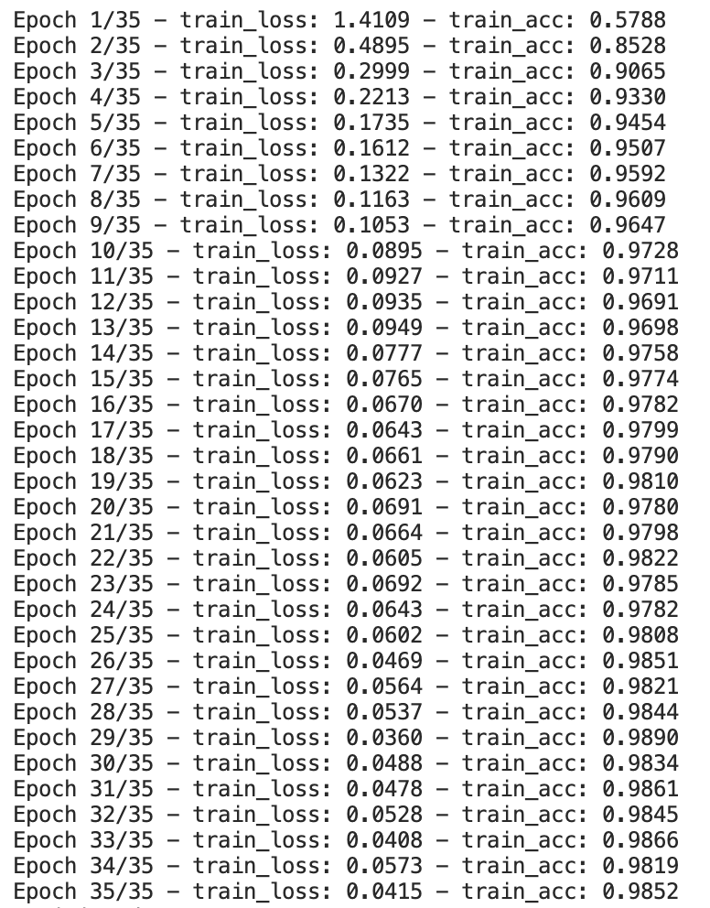
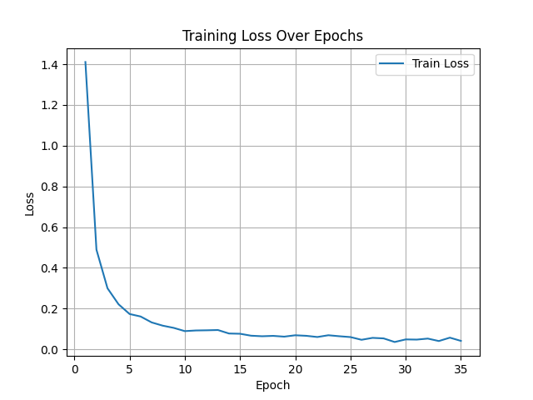
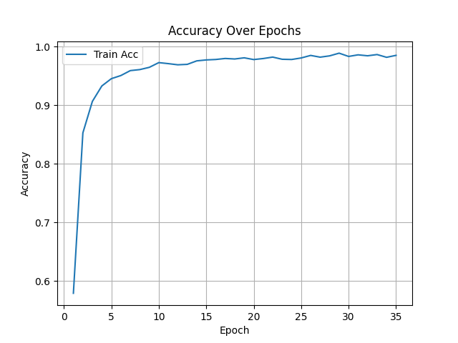
Results From Training
Final test accuracy: 0.9945
11 misclassified examples

Slide 5
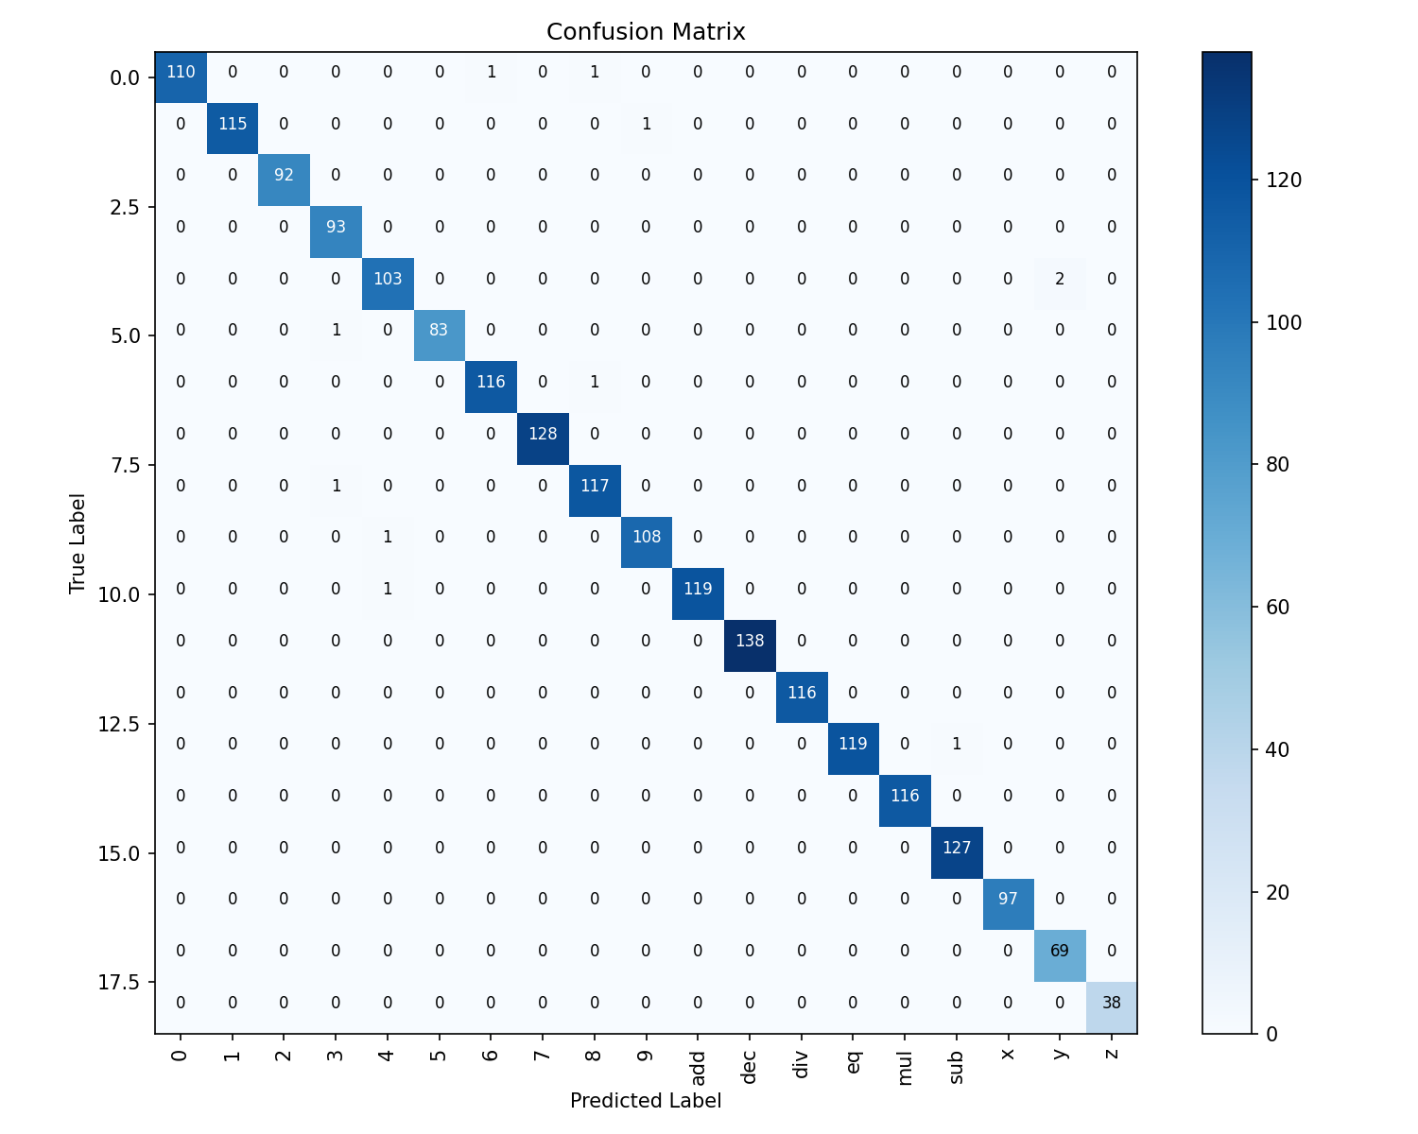
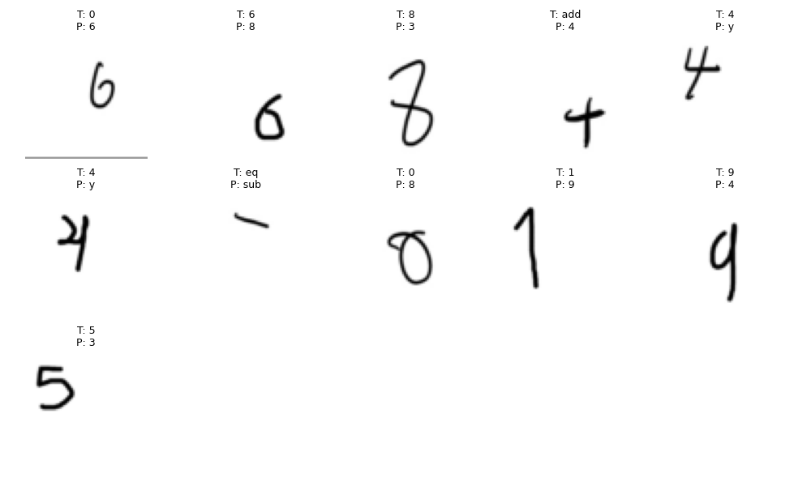
Test Results

Slide 6
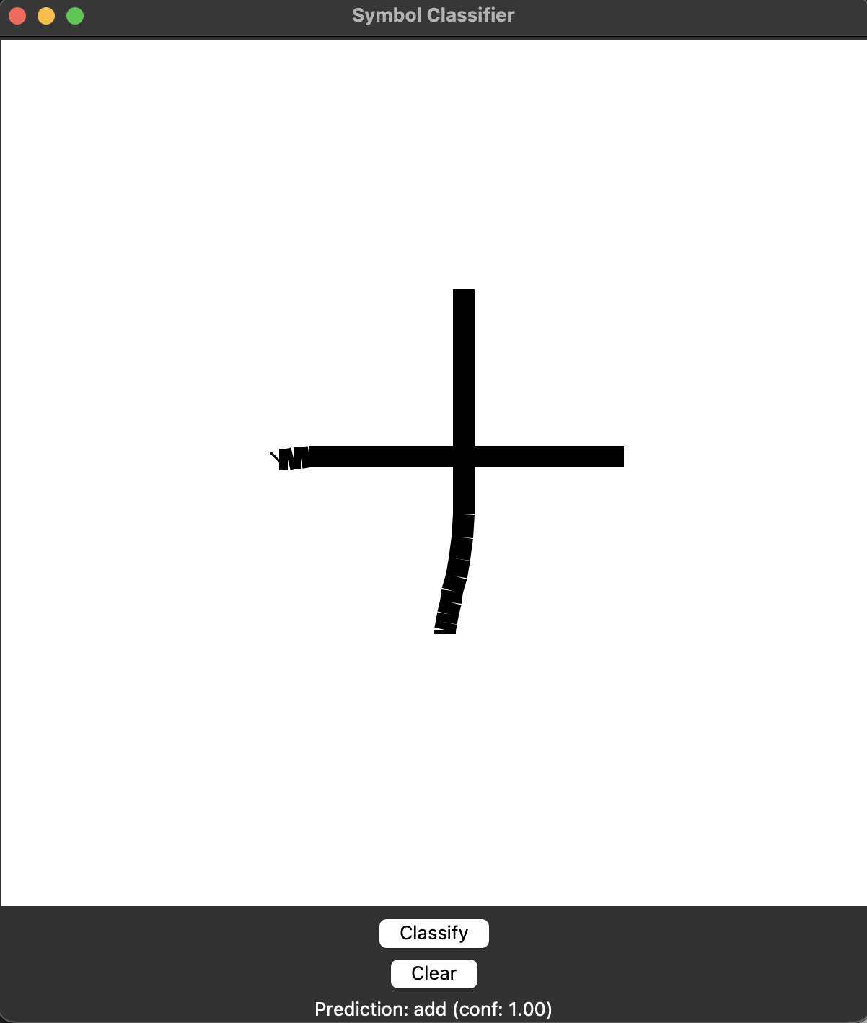
Symbol Predictor
Works like digit_predictor.py
Outputs prediction and confidence

Slide 7
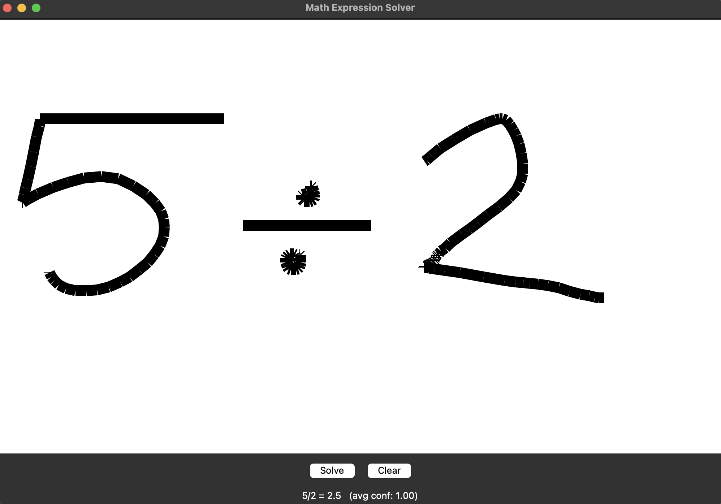
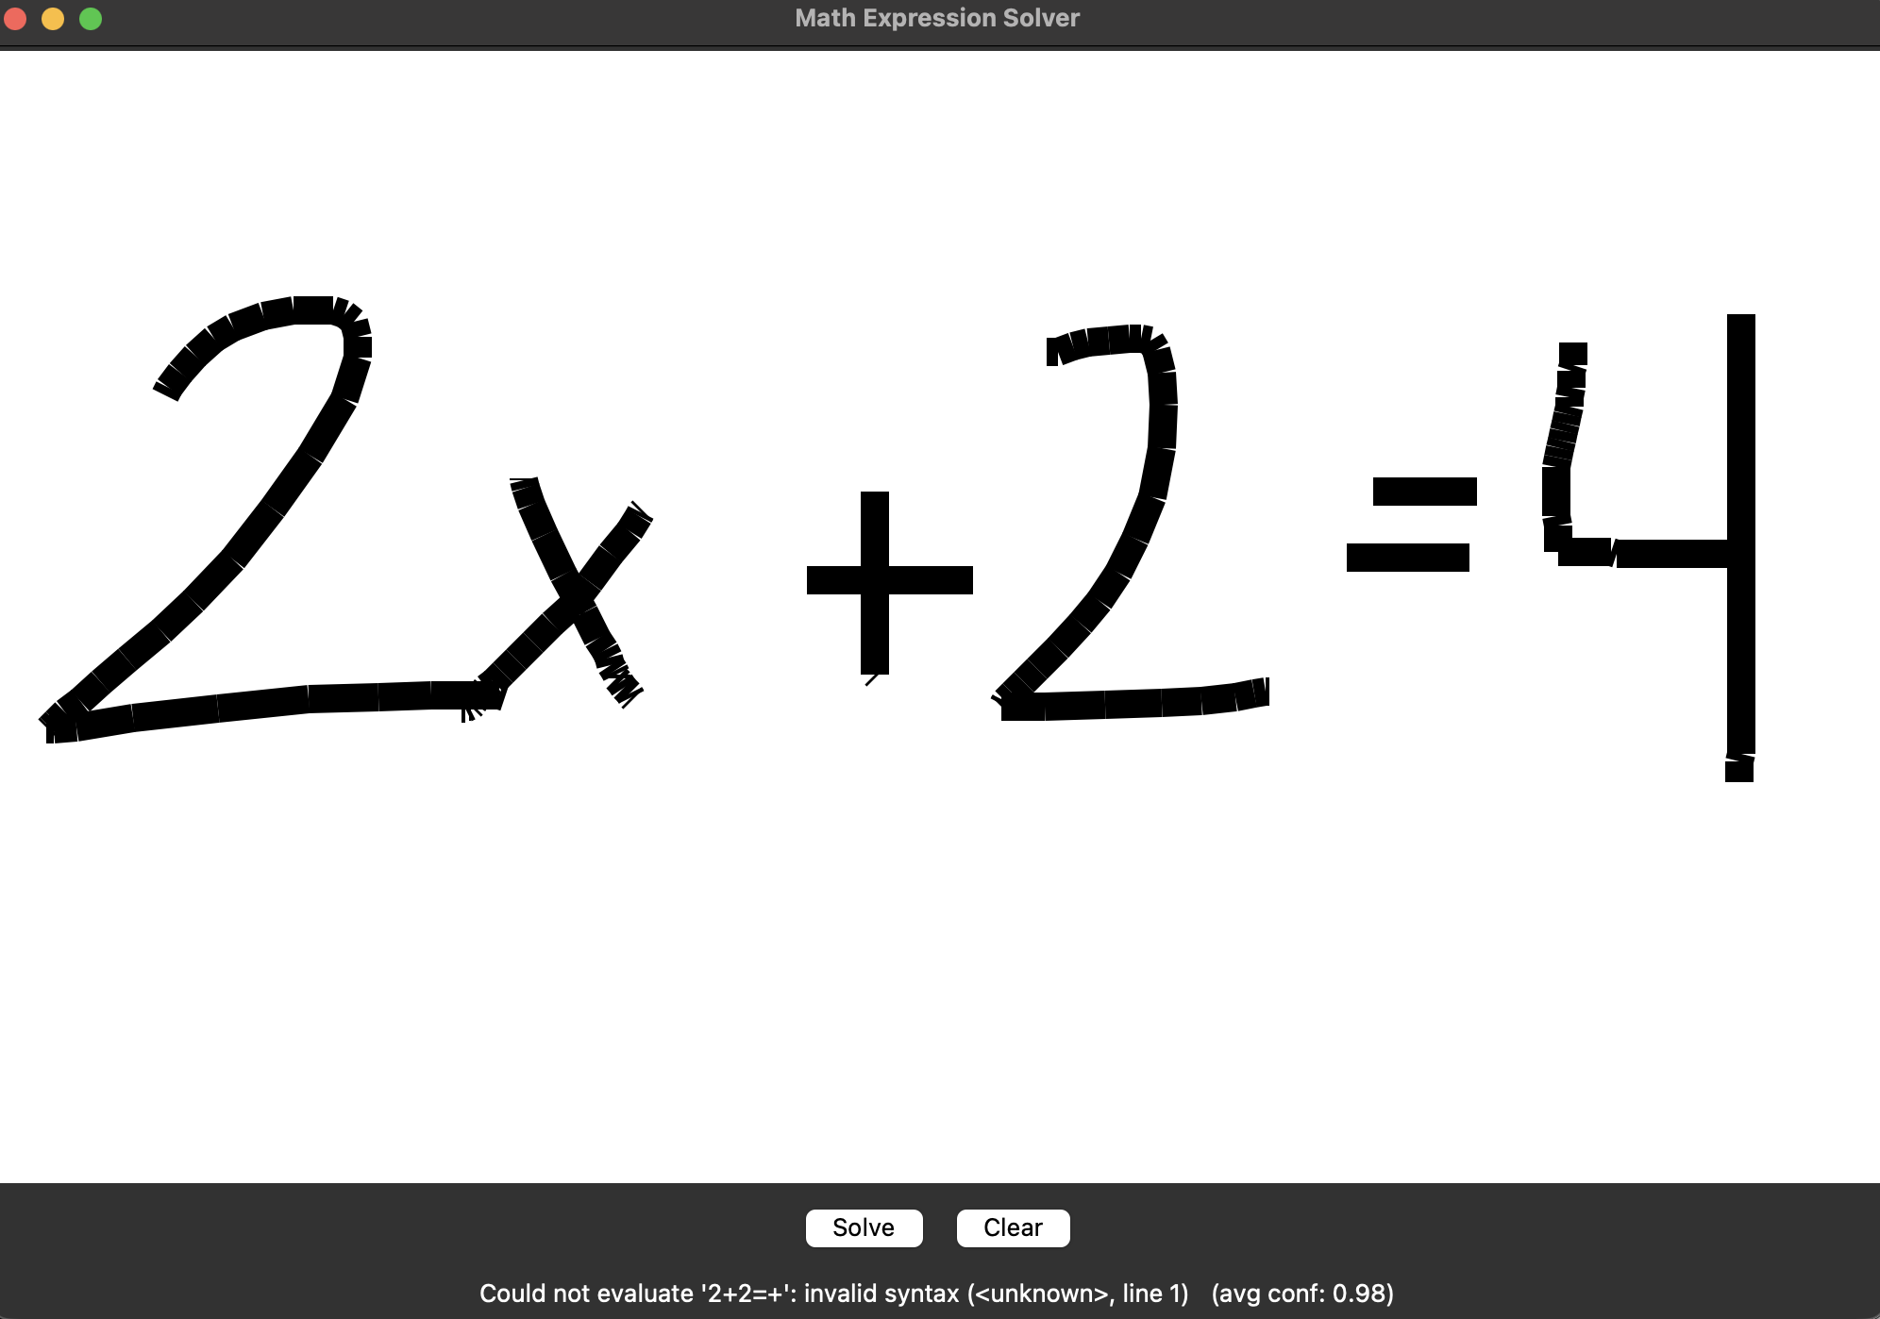
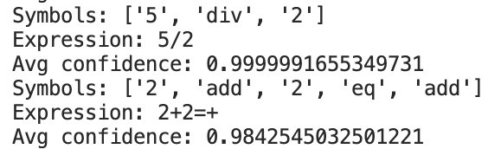
Bonus: Math Solver
Build on symbol predictor
Have the solver cut statement into blocks and try and solve
Not always super accurate
Output:

Slide 8
References
[Kag, ] Handwritten Math Symbols. https://www.kaggle.com/datasets/sagyamthapa/handwritten-math-symbols/data. [Accessed 12-1-2025].
[ONN, ] Load and Run an ONNX Model. https://onnx.ai/onnx-r/articles/onnx_model_zoo.html. [Accessed 12-1-2025].
[Esra Soylu, ] Esra Soylu. Creating a CNN Model for Image Classification with TensorFlow. https://medium.com/@esrasoylu/creating-a-cnn-model-for-image-classification-with-tensorflow-49b84be8c12 [Accessed 12-1-2025].

